Slide 1
Creating web application

Slide 2
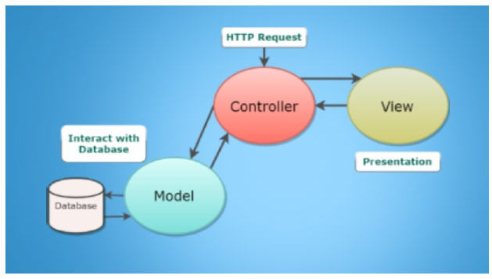
What is MVC
MVC = Model View Controller
See next slide more details
Model – responsible for data
Controller – responsible for logic of the application
View – responsible for what user of the application see

Slide 3
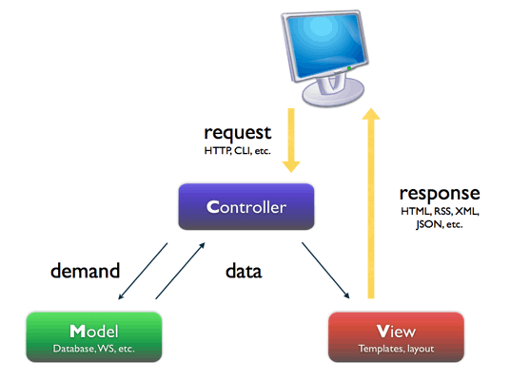
How does MVC work?
MVC = Model View Controller
User from computer sends http request
Controller is picking up the request
Controller contacts database using →
Model knows how to ask DB for data, how to do CRUD
Controller gets data from DB using Model
Controller finishes it’s work by preparing View
View is sent to user by response

Slide 4
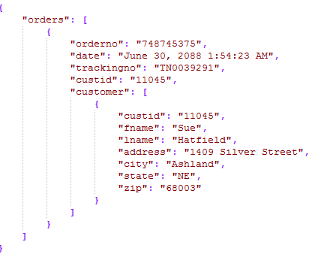
Web API
Web Api is similar to general Web app, with just one difference:
IT DOESN’T HAVE FRONTEND
Actually it’s frontend is the result in JSON:

Slide 5
Let’s create the web application
We want to make a web application
The goal is to use Database, C# program and Javascript
We can choose any project we like
If we don’t come up with any other idea, we can make the website which will allow us to show different popular movies

Slide 6
Before we start
Decide whether to use MVC app or Web API
Decide whether to start from the Backend or the Frontend
Analyze what the application should do
Analyze what the application should look like
Be prepared for many obstacles on our way
Create piece by piece and put it slowly together
Good luck to us!

